Slide 1
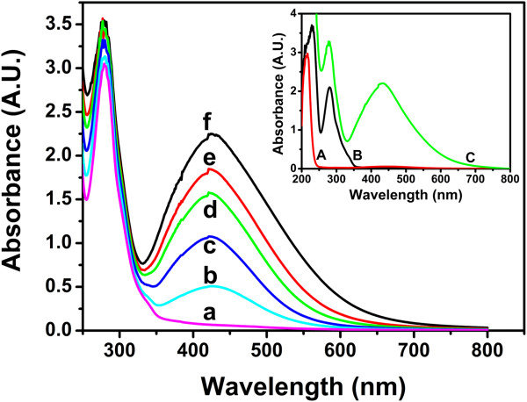
TITLE
PROBLEM STATEMENTS & OBJECTIVES
RESEARCH METHODOLOGY
ASSESSMENT GUIDELINES AND SESSION SCHEDULE
The poster presentation should describe:
Problem/issues related to material and/or technology
Novelty of the research
Innovation/ discovery / research approach
Impact / significance of the work
Potential application / commercialization
The presentation will be evaluated based on the following criteria and can be referred from the attached assessment form template:
the presentation of the research, including visual aspects of the poster,
the research, specifically the quality, novelty, and significance of the contribution,
potential application and commercialization of the result / product
the presenter’s verbal discussion via a short presentation of their research
followed by a question and answer period, which will be evaluated by a panel of
judges.
Novelty of Project/ Innovation / Discovery
Research impact / Significant contribution to society
POTENTIAL APPLICATION / COMMERCIALIZATION
EXAMPLE
Figure 1: Absorbance spectra
(lin et.al. 10.1186/1556-276X-8-318)
Author¹
^{1,}Affiliation.
^{2,}Affiliation.
Email:
Contact no: +60
Author^{2*}
^{1,}Affiliation.
^{2,}Affiliation.
Email:
Contact no: +60
REFERENCES

